Slide 1
Progress in SIC Simulation
Modify equalizer (FDE), encoder (support code rate n/m)

Slide 2
System Architecture
Transmitter Receiver
Binary Data |  | Received Signal
Encoder |  | Remove CP
 |  |  |  |  |  | Subtraction
Modulation |  | Equalizer |  | Reverse Eq.
IFFT |  | FFT |  | IFFT |  | Equalizer
Add CP |  | Demodulation |  | Modulation |  | FFT
Channel |  | Decoder |  | Encoder |  | Demodulation
 |  | signal #1 |  |  |  | Decoder
 |  |  |  |  |  | signal #2

Slide 3
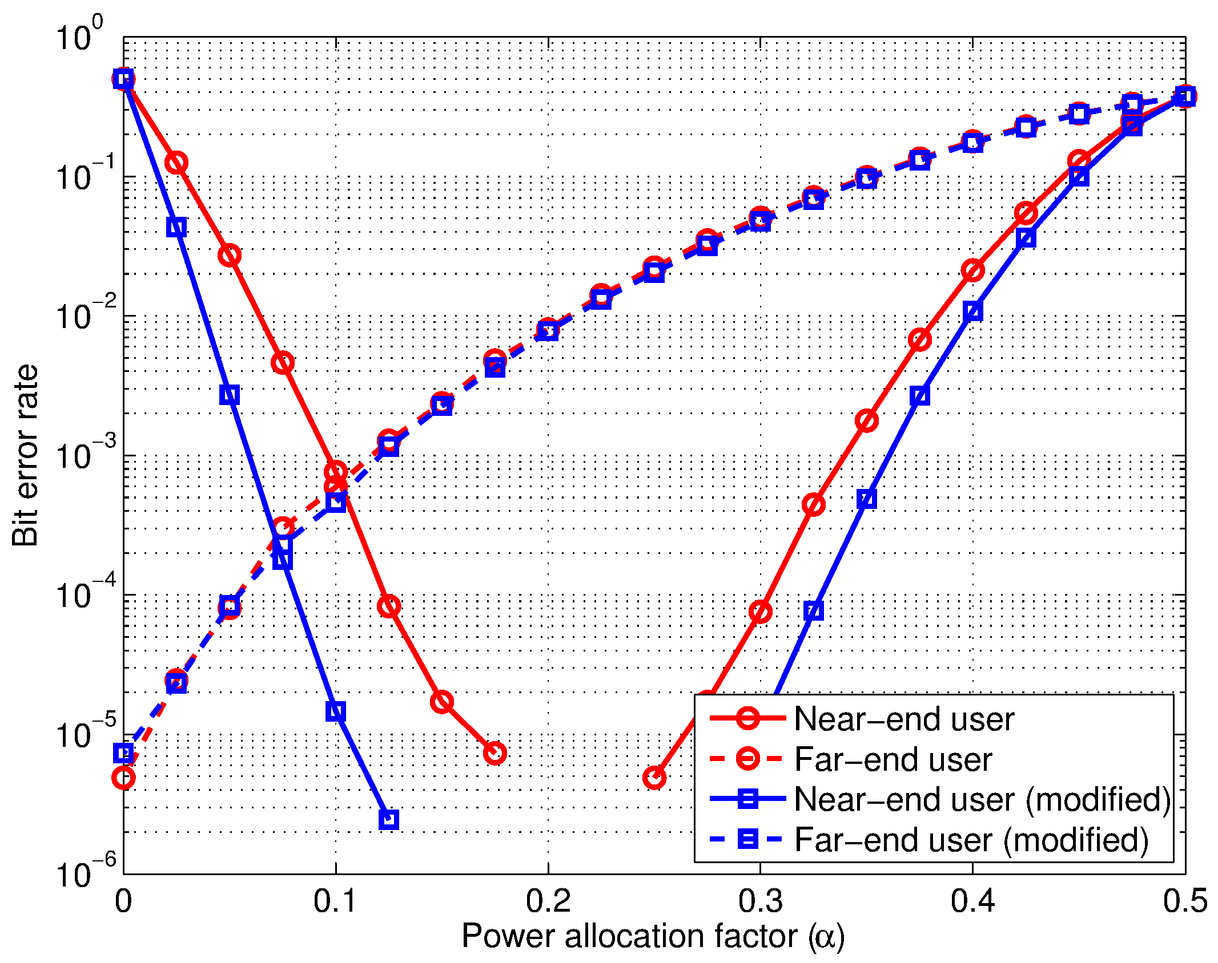
Modified Receiver
Received Signal
Remove CP
FFT
Equalizer
Demodulation
Decoder

Slide 4
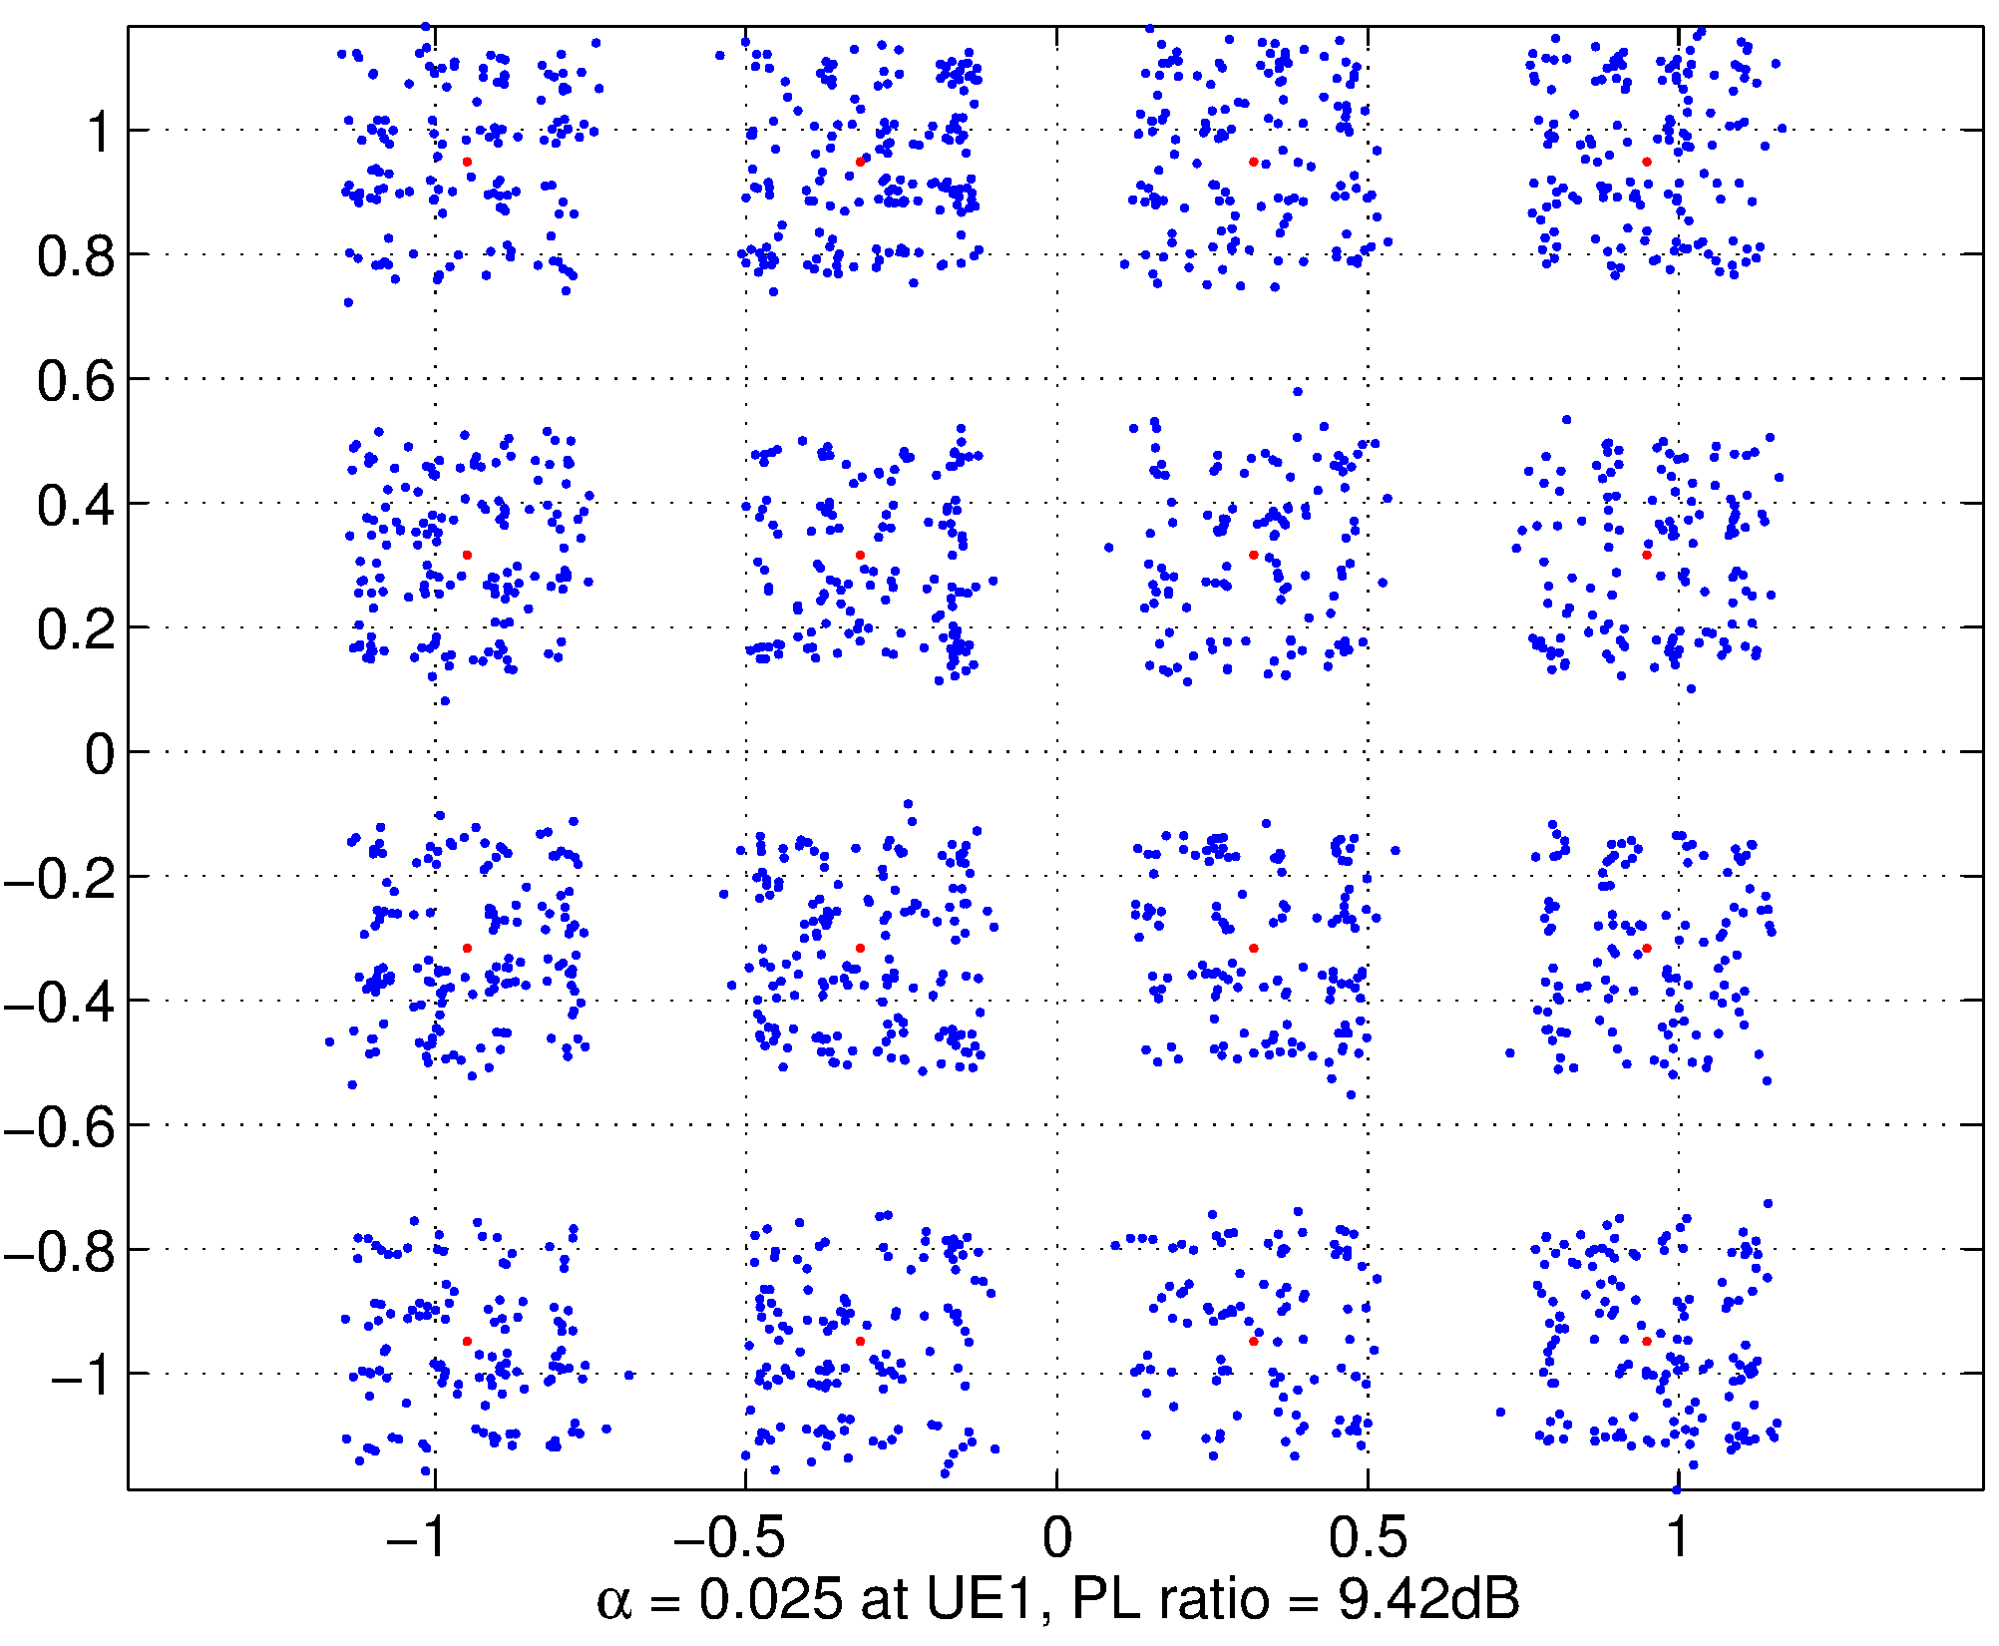
Verify power allocation factor (UE1)
Pathloss Ratio(9.42dB)
ITU pedestrian channel(3km/s)
4000 random samples
16QAM

Slide 5
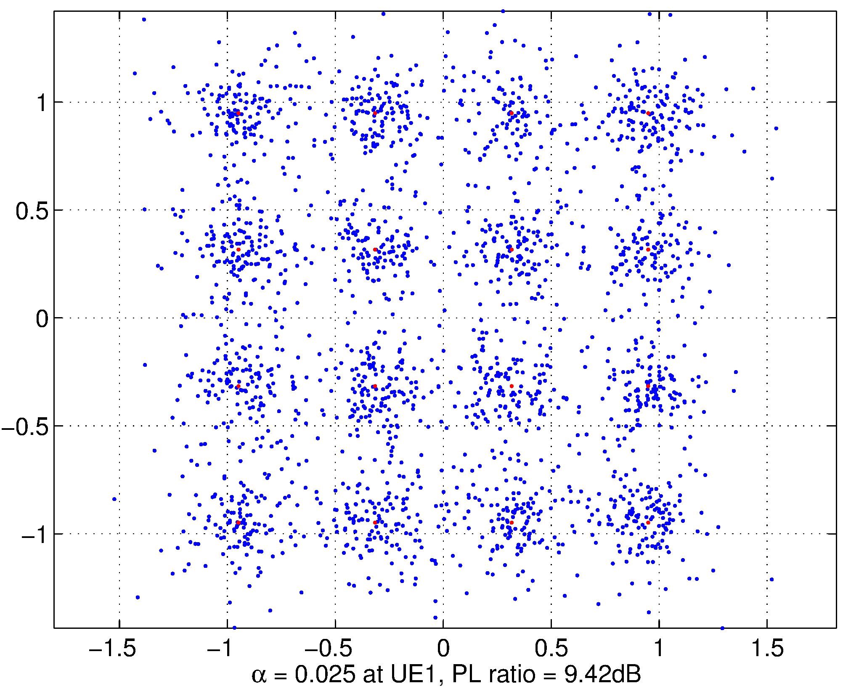
Verify power allocation factor (UE1)

Slide 6
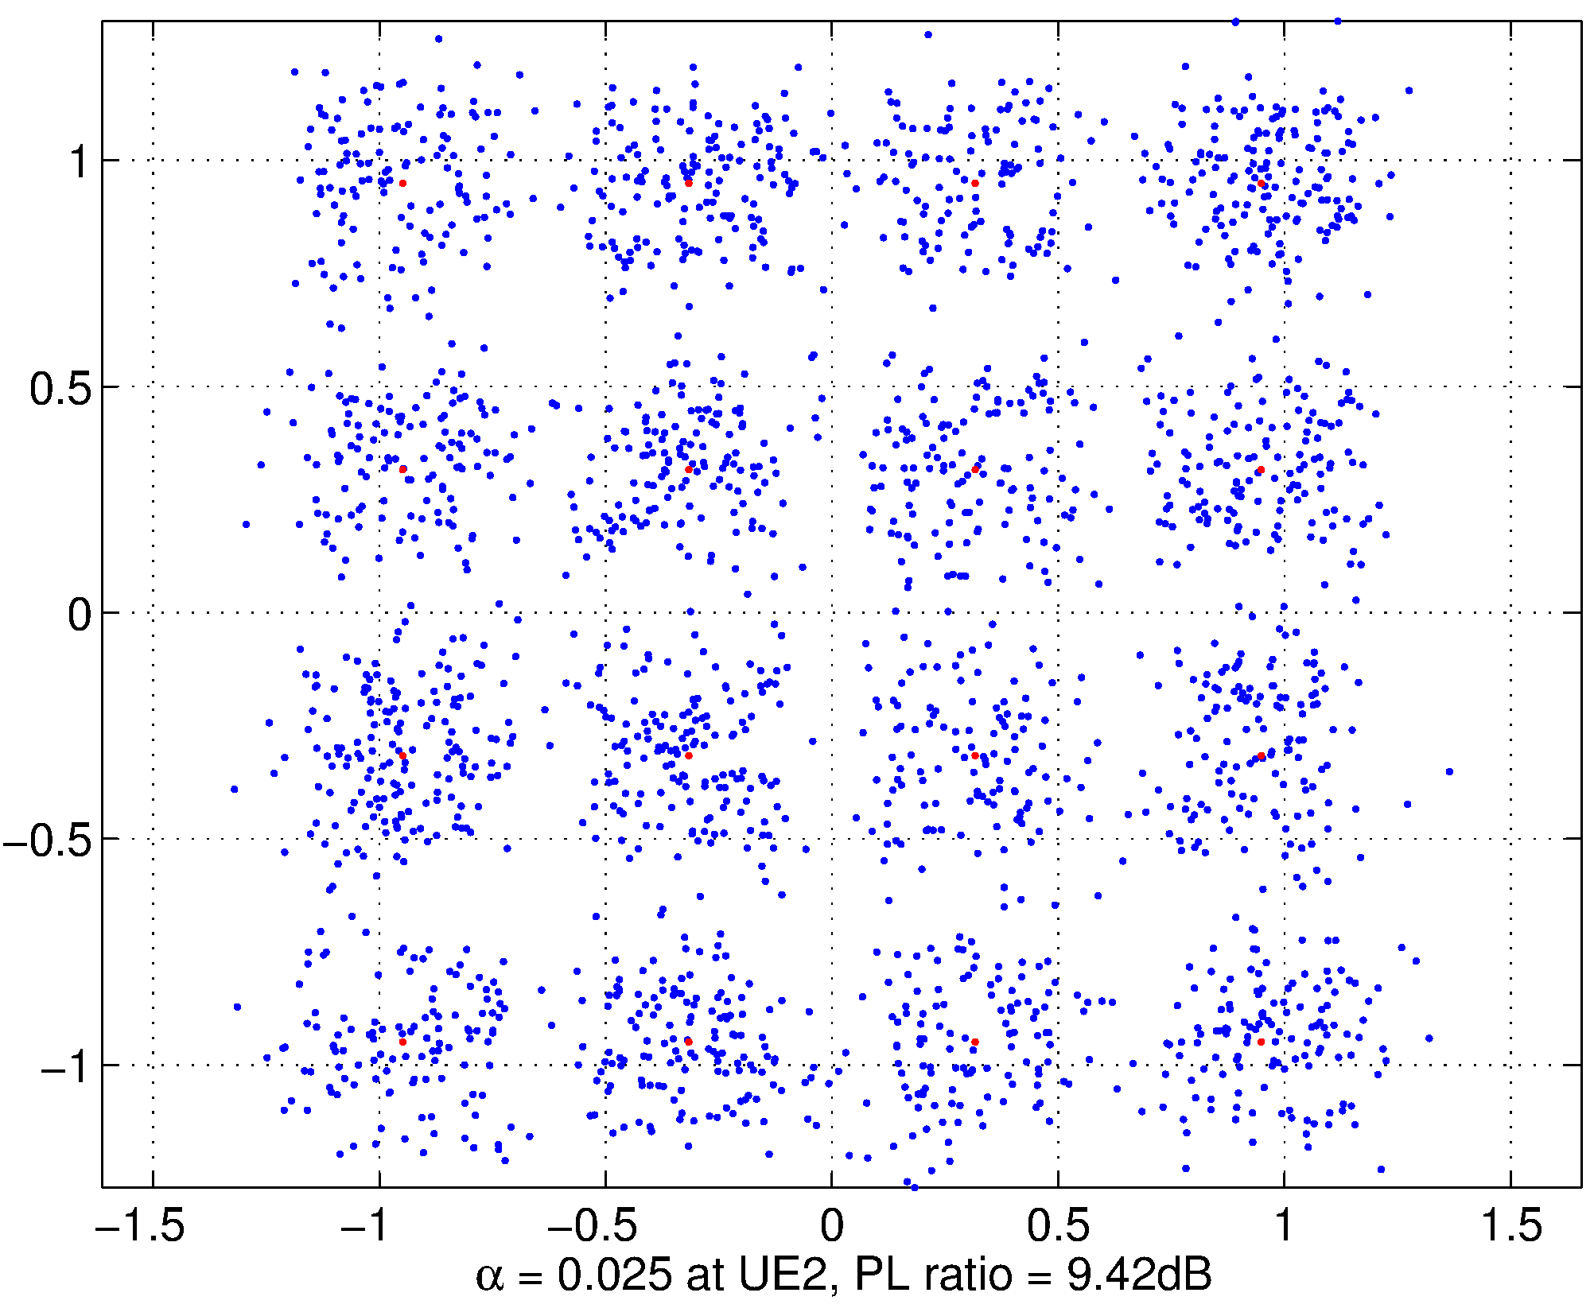
Verify power allocation factor (UE2)

Slide 7
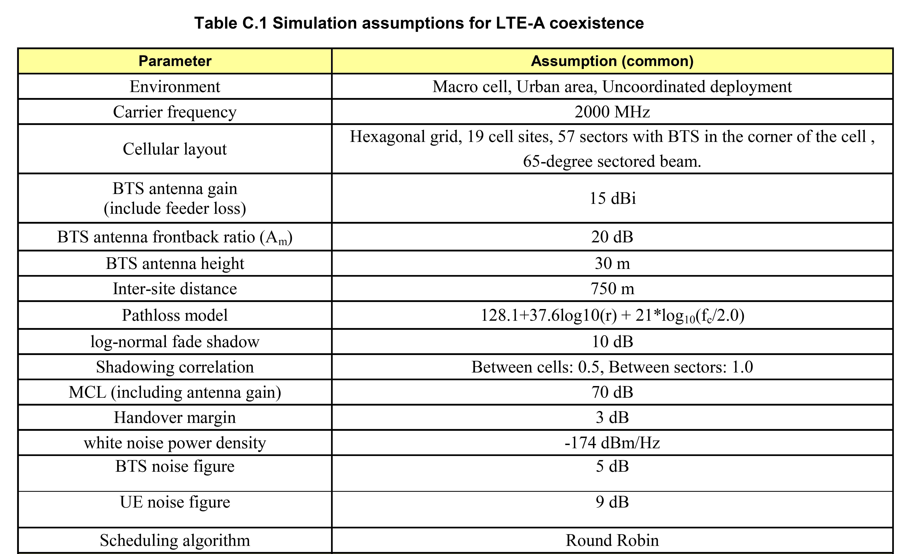
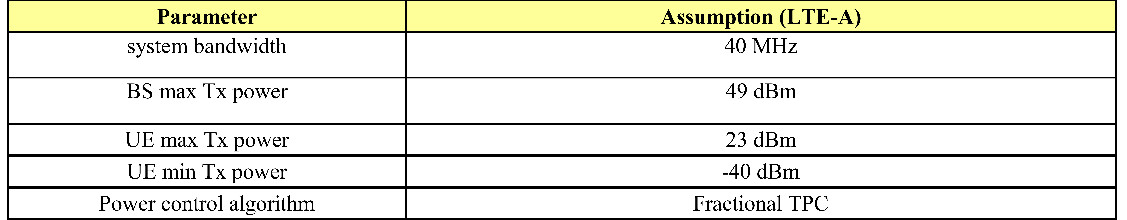
3gpp - Simulation Parameters

